Slide 1
Ancient Greece

Slide 2
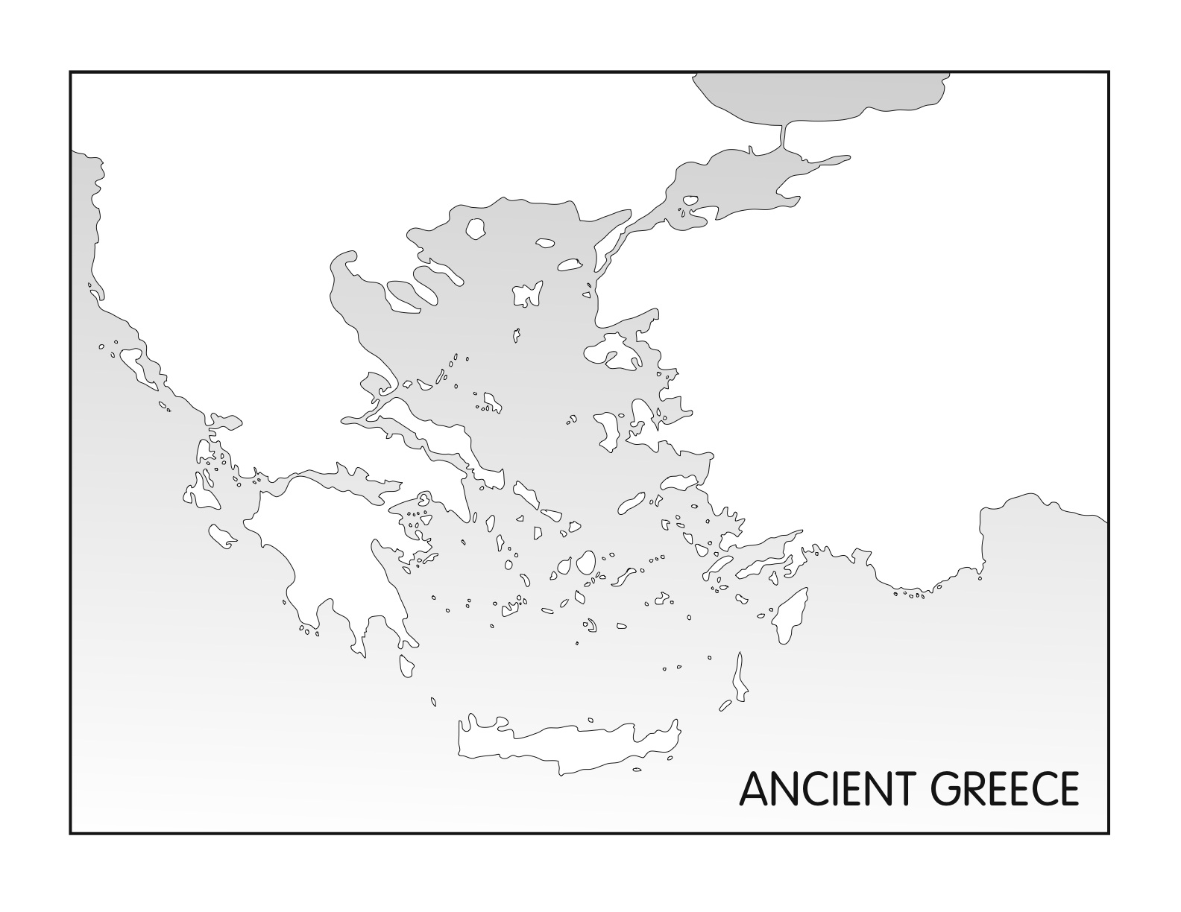
Mt. Olympus
Greece
Turkey
Aegean Sea
Athens
Ionian Sea
Sparta
Crete
Mediterranean Sea

Slide 3
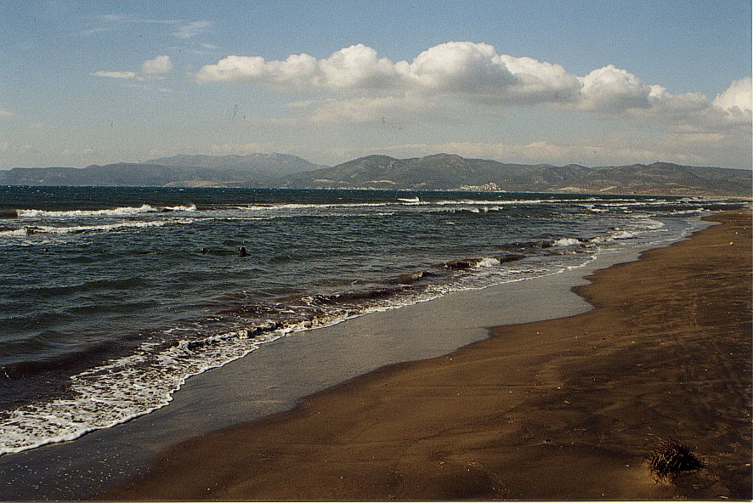
Greek Geography:
Location “Around” The Seas
2,000 islands on Aegean & Ionian Seas
Provided transportation link for various regions of Greece
Connected Greece to other societies through trade
  Greece lacked natural resources – used sea to get them from other lands

Slide 4
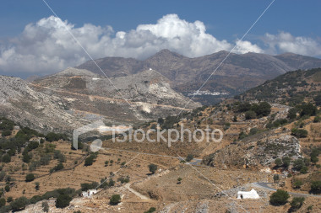
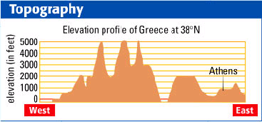
Greek Geography:
Rugged Mountains
75% of land covered by mtns
Made unification difficult
  Developed into small, independent communities called city-states
  Loyalty lay with these city-states

Slide 5
Greek Geography:
Little Fertile Farmland
Resulted in small population
Created a need for colonies

Slide 6
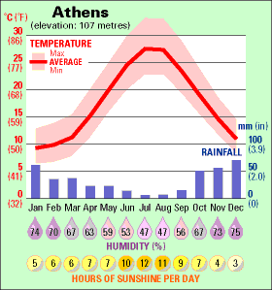
Greek Geography:
Moderate Climate
Moderate temps (48˚ winter, 80˚ summer)
Developed an outdoor life for Greek males
  Exs: meetings, discussions

Slide 7
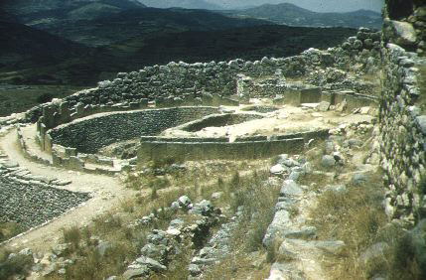
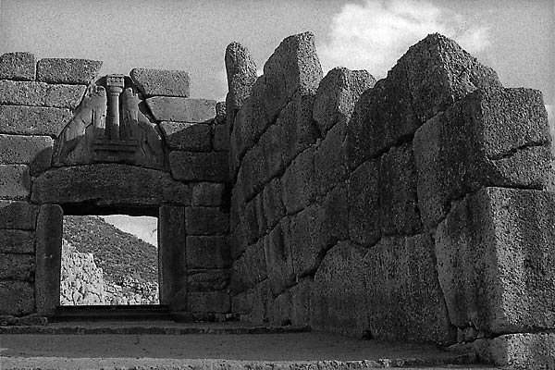
Early History:
Mycenaean Adaptation of Minoan Culture
Came into contact with Minoans around 1500 B.C.
Adapted Minoan writing system, artistic design, & culture
  Later formed core of Greek religious practices, politics, & literature
  Western civilization has its roots in these two early Mediterranean civilizations

Slide 8
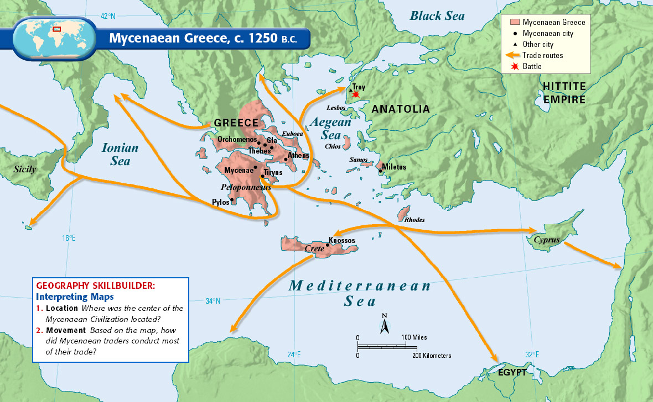

Slide 9
Early History:
The Trojan War
1200s B.C. – Mycenaean’s fought 10-yr war against Troy
Provided basis for legend/epic
  Says Greek army destroyed Troy because Trojan prince had kidnapped Helen, beautiful wife of Greek king
May have contributed to collapse of Mycenaean civilization

Slide 10
Early History:
Collapse of Mycenaean Civilization
Dorians attacked & burned many Mycenaean cities
Led to decline in economy, trade, & writing under Dorians

Slide 11
Early History:
Dorians
“Dark Ages” of Greek history
Less advanced civilization
Economy collapsed
Trade subsided
No written records exist

Slide 12
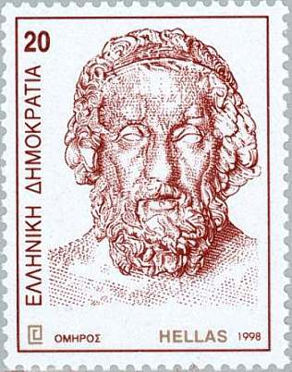
Early History:
Epics of Homer (Dorian Age)
No written records → stories spread through spoken word
Homer was greatest (750-700 B.C.)
  Blind man who composed epics (narrative poems) celebrating heroic deeds
  Composed The Iliad & The Odyssey
    Trojan War forms backdrop for The Iliad

Slide 13
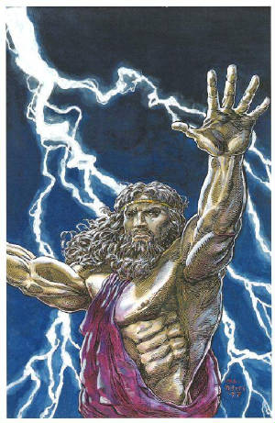
Early History:
Myths Created
32g Describe polytheism in the Greek world
Myths = traditional stories about gods
Attached human qualities to their gods
Zeus was the ruler of the gods who lived on Mt. Olympus with wife, Hera
Athena, goddess of wisdom, daughter of Zeus
  Athens named in her honor

Slide 14
Development of the Polis
Polis = city-state
  Fundamental political unit
Advantages
  Small, easy to control, centralized
Disadvantages
  Controlled little territory, many rivals nearby, greater chance for conflict

Slide 15
Different Forms of Greek Gov’t
Monarchy
Aristocracy
Oligarchy
Direct Democracy

Slide 16

Different Forms of Greek Gov’t
Monarchy
State ruled by a king
Rule is hereditary
Some rulers claim divine right
Practiced in Mycenae by 2000 B.C.

Slide 17


Different Forms of Greek Gov’t
Aristocracy
State ruled by nobility
Rule is hereditary & based on family ties, social rank, & wealth
Social status and wealth support ruler’s authority
Practiced in Athens prior to 594 B.C.

Slide 18


Different Forms of Greek Gov’t
Oligarchy
State ruled by a small group of citizens
Rule is based on wealth or ability
Ruling group controls military
Practiced in Sparta by 500 B.C.

Slide 19

Different Forms of Greek Gov’t
Direct Democracy
State ruled by its citizens
Rule is based on citizenship
Majority rule decides vote
Practiced in Athens by about 500 B.C.

Slide 20
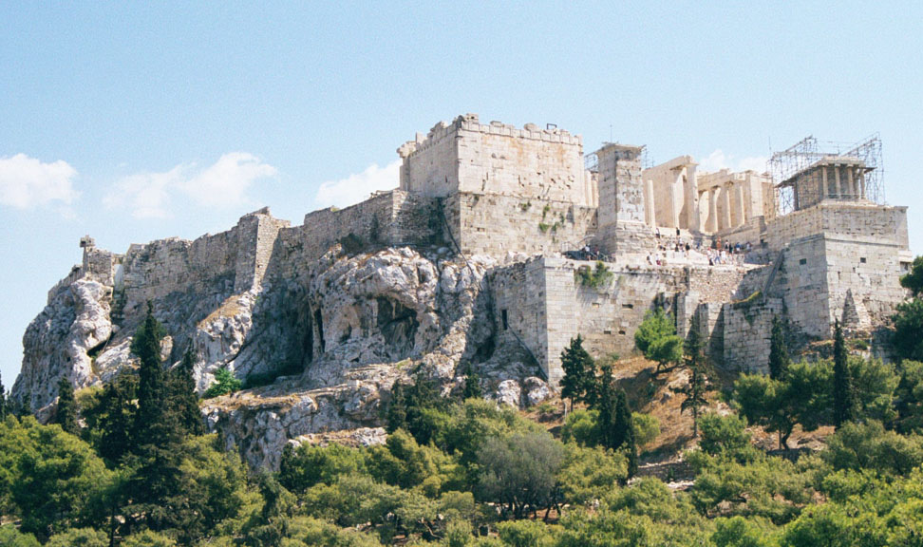
Important Places in Athens
Acropolis
  Fortified hilltop where citizens would gather to discuss city gov’t
Agora
  Marketplace

Slide 21
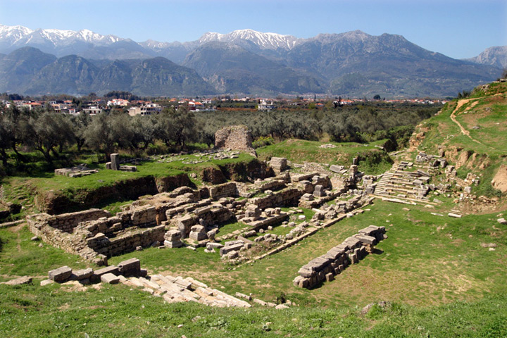
725 B.C.
Sparta conquers Messenia
Made them helots
  Peasants forced to stay on the land they worked and turn over half their crop each year to the Spartans

Slide 22
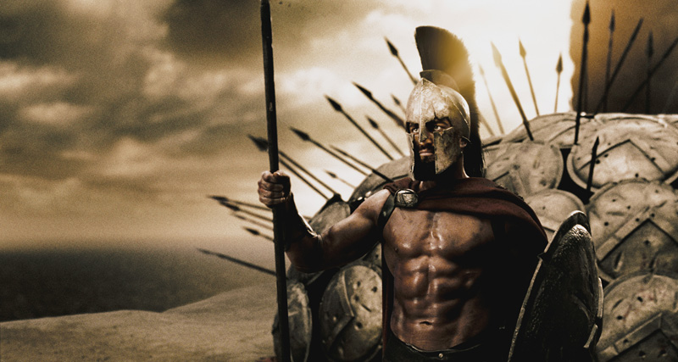
650 B.C.
Spartans put down Messenian revolt
In response, Spartans made themselves a strong, highly-disciplined military state

Slide 23
Sparta
Government
  Council of Elders – 30 older citizens
  2 kings ruled over Sparta’s military forces
Valued duty, strength, & discipline

Slide 24
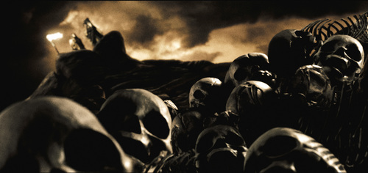
Sparta
Daily Life - Boys
Centered on military training
Boys left at age 7 – moved into army barracks
Days spent marching, fighting, exercising
  All weather – only tunics, no shoes
  No blankets, slept on hard benches
  Bowl of black porridge (encouraged to steal)
  Produced tough, resourceful soldiers

Slide 25
Sparta
Daily Life - Girls
Service to Sparta above everything else
Taught to be mothers, wives
“Come back with your shield or on it.”

Slide 26
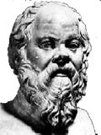
621 B.C.
Draco (Athens) writes the first legal code
Code based on idea that all Athenians were created equal
Harsh punishment
  Death for nearly every crime

Slide 27
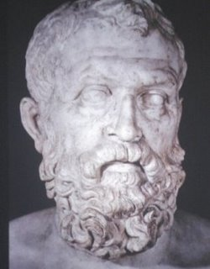
594 B.C.
Athenian aristocrats choose Solon to govern
Outlawed debt slavery
All citizens could participate in the Assembly

Slide 28
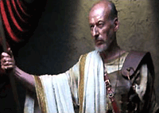
500 B.C.
Cleisthenes introduces political reforms in Athens
Allowed all citizens to introduce laws
Created Council of 500
  Chosen at random, proposed laws, counseled Assembly

