Slide 1
Egypt SPICE Chart
Page 18

Slide 2
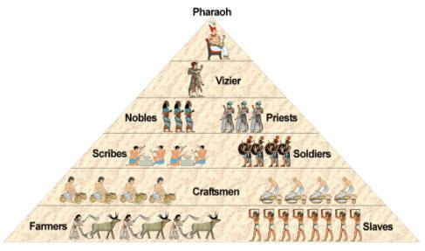
Society
Social Hierarchy

Slide 3
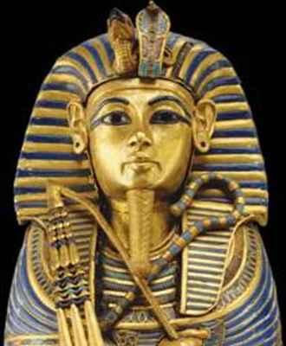
Political
Theocracy
Pharaoh = god-king
believed to rule even after death
Dynasties

Slide 4
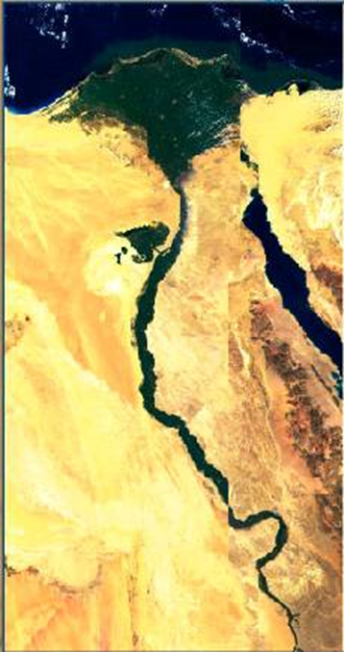
Interactions
Nile River
Predictable yearly flooding
Irrigation
Calendar
Surrounded by desert
Provides a natural barrier
Papyrus: a paper-like writing material created from the papyrus plant that grows on the banks of the Nile River

Slide 5
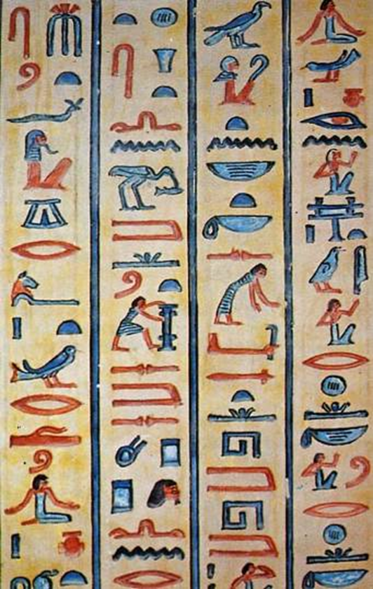
Culture
Hieroglyphics – writing system
Religion
Polytheistic
Animistic
Pyramids
Mummification

Slide 6
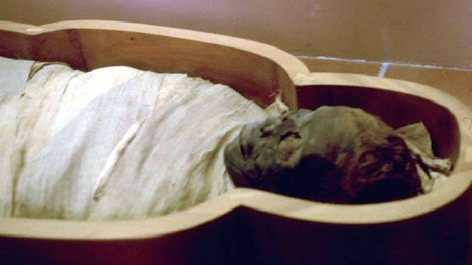
Preparation for Afterlife

Slide 7
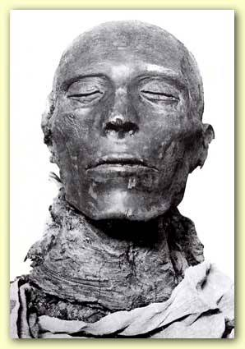
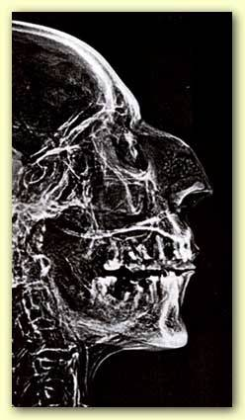
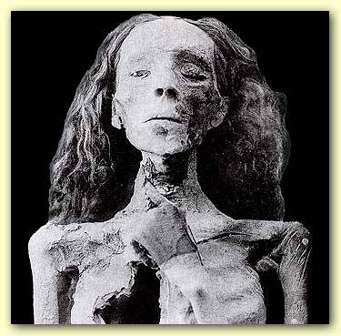
Egyptian Mummies
Seti I 1291-1278 B. C. E.
Ramses II 1279-1212 B. C. E.
Queen Tiye, wife of Amenhotep II 1210-1200 B. C. E.

Slide 8
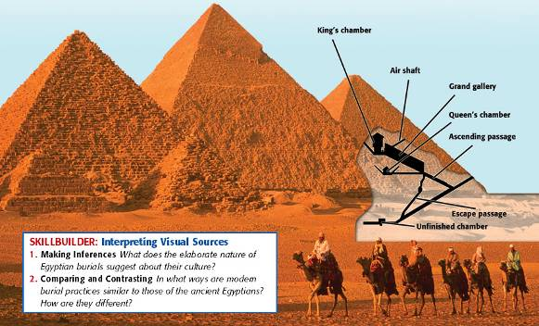
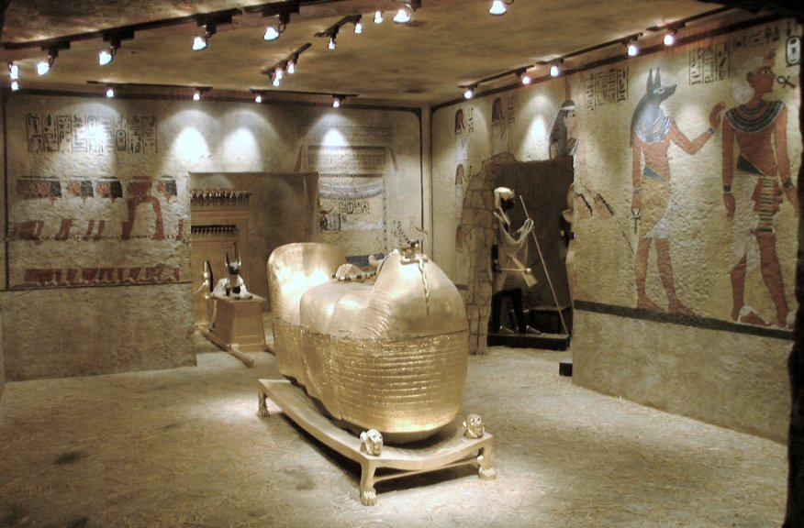
Pyramids
Egyptians believed kings had eternal spirits
Built pyramids as tombs for pharaohs (resting places from which their rulers could reign forever after death)

Slide 9
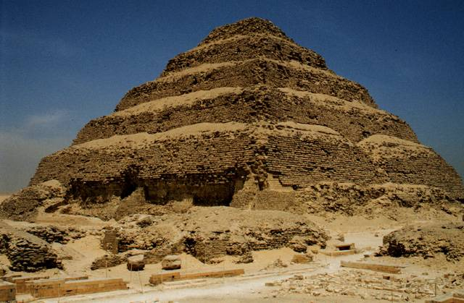
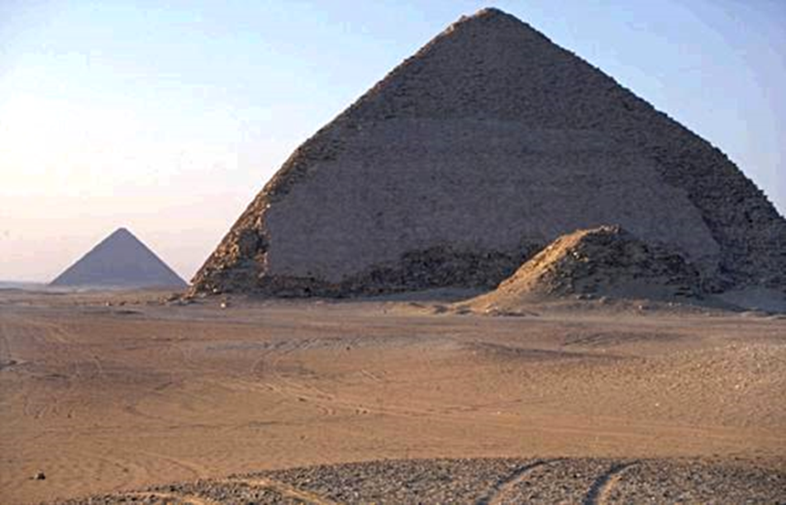
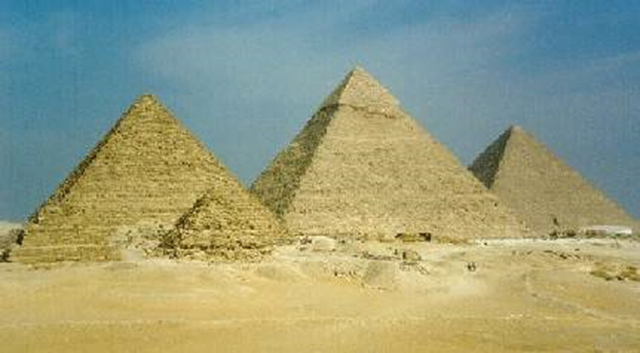
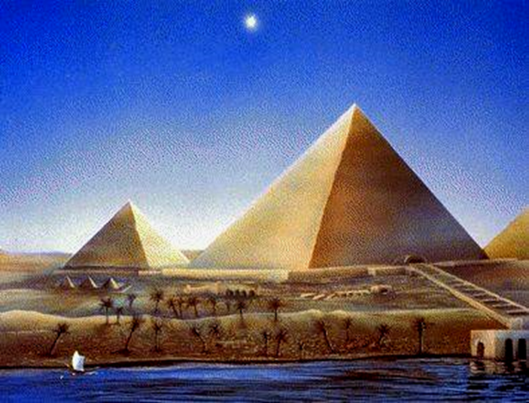
Stepped Pyramid at Saqqara
“Bent” Pyramid of King Sneferu
Giza Pyramid Complex

Slide 10
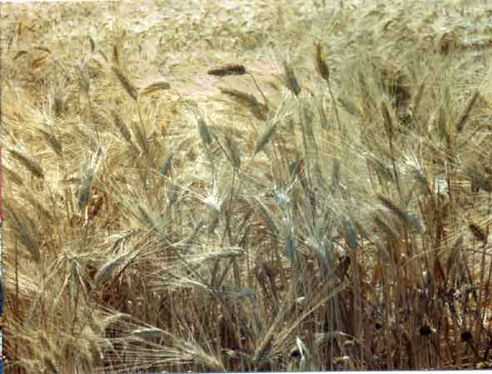
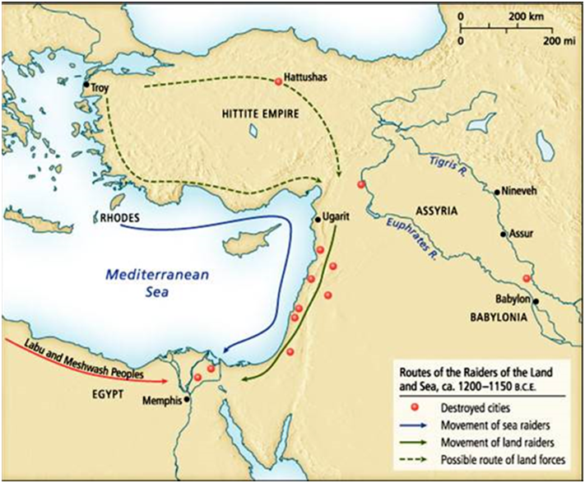
Economics
traded agricultural surplus: wheat barley (from Nile which provided silt)
mining of large mineral deposits
Slave labor

