Slide 1
Feudalism
A political system in which nobles are granted the use of lands that legally belong to their king, in exchange for their loyalty, military service, and protection of the people who live on the land.

Slide 2
Fief -- revenue-producing property granted by a liege lord in return for a form of allegiance
Lord -- has aristocratic rank and claims dominion over a portion of land and the produce and labor of the serfs living thereon.
Vassal --one who enters into mutual obligations with a lord, usually of military support and mutual protection, in exchange for certain guarantees, which came to include the terrain held as a fief.

Slide 3
King
Powerful Lords
Lesser Lords
Knights
Freemen, Townspeople
Serfs
Villains
Peasants

Slide 4
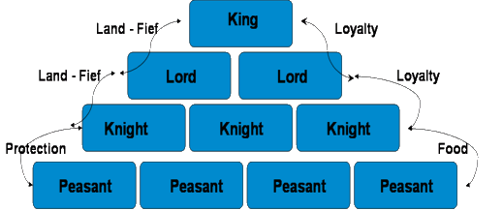
Feudalism

Slide 5
Manorialism
The economic system of the middle ages

Slide 6
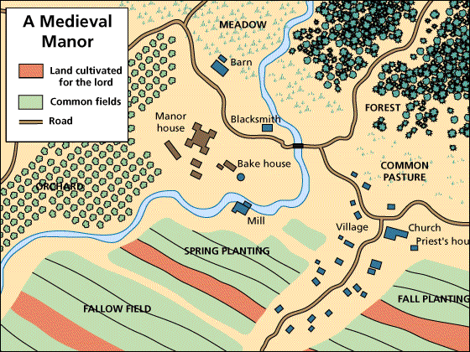
The Manorial System
Manors
Self-contained communities that dotted the countryside throughout western Europe

Slide 7
Serfs (villein)-- laborers who are bound to the land;
they formed the lowest social class of the feudal society.

Slide 8
Serfs’ Role Lord’s Role
work certain lands and to pass those lands on to their heirs
In exchange they had to perform labor services and pay rents in kind (a portion of the harvest, chickens, eggs, etc)
Protection from war and famine
Provide small scale government
Maintain court and receive any grievance.

Slide 9
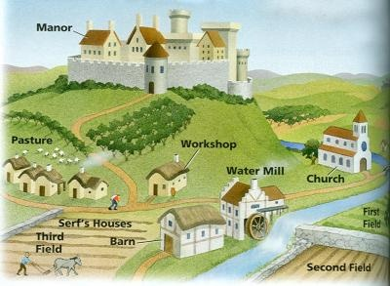
The Medieval Manor
Nearly self-sufficient village
Grew all food needed in the village
Raised all animals needed in the village
Grew or raised all fiber needed to make cloth
Ground own grain, baked own bread

