Slide 1
The Roman Empire
The Pax Romana, From Augustus to Aurelius

Slide 2
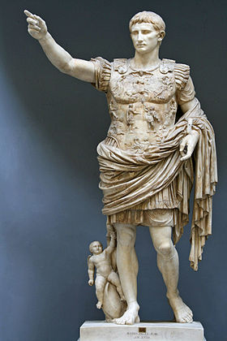
Where Were We?
Julius Caesar was killed, but many still supported his ideas.
Two of them, Octavian and Marc Antony, go to war with Caesar’s assassins.
Octavian and Antony end up in a civil war of their own afterwards.
27 BC: Octavian changes his name to Augustus Caesar, declaring himself Rome’s first Emperor.

Slide 3
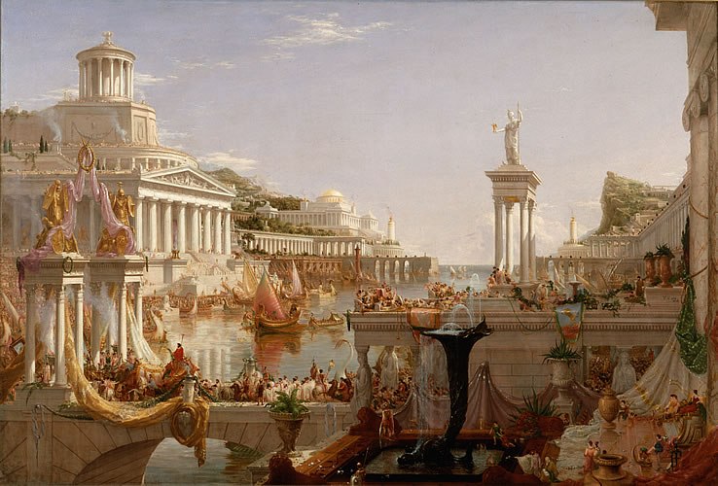
The Roman Empire
Autocracy: Government run by just one person. The Emperor has absolute power!
Controls the military, but also means the military chooses successor.
The Senate still exists, but no longer has real power.
Early years of Roman Empire (27 BC-180 AD) called Pax Romana (“Roman Peace”)

Slide 4
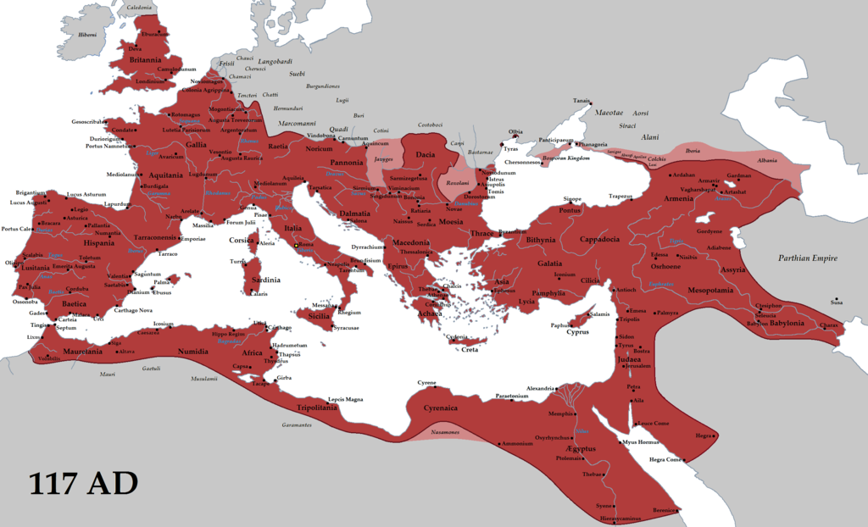
Expansion
Britain
Germany (just a little bit)
Rome peaks under Emperor Trajan (98-117): takes Dacia, Armenia, Mesopotamia, and Nabataea.
Provinces mostly left alone. Only two big rules:
1. Pay your taxes.
2. Worship the Roman gods!

Slide 5
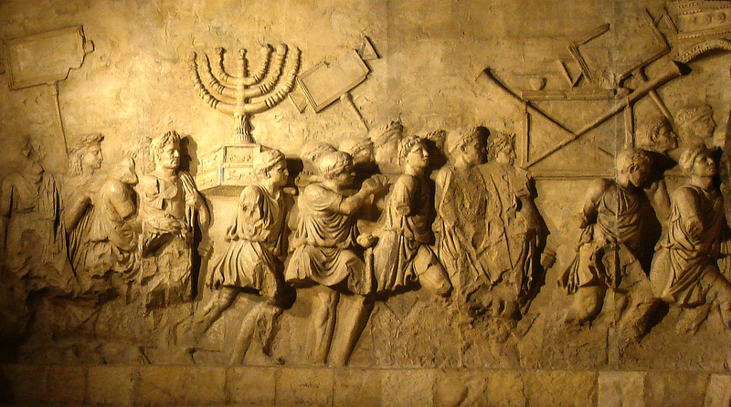
Religion
Past Emperors were made gods after they died.
Current Emperor was also Pontifex Maximus (“High Priest”)
Foreign gods were incorporated into Rome’s own. (Jupiter = Zeus = Thor = Ra)
Mystery cults.
Conflicts with Jews/Christians.

Slide 6
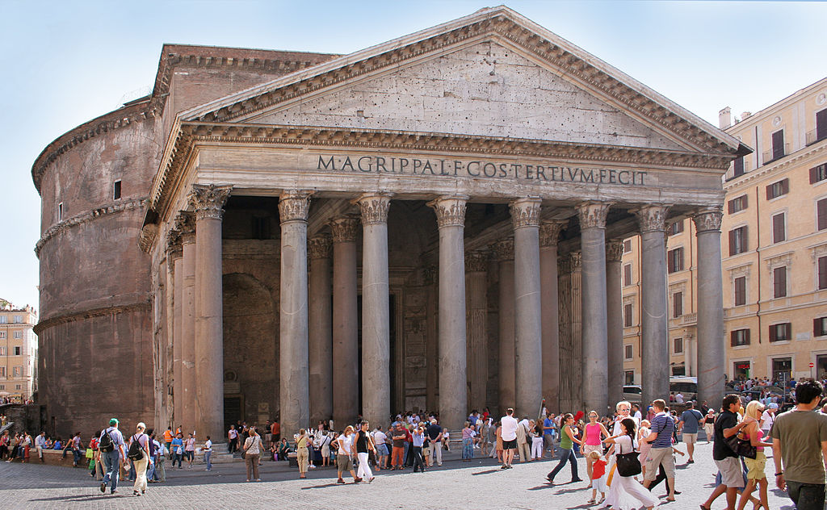
Engineering
Roman roads allowed for easy travel throughout the Empire.
Roman aqueducts made sure every town had access to water.
Impressive public works projects, including temples, theaters, and stadiums.
Many Roman structures still exist today!

