Slide 1
PictoWords

Slide 2
What is a pictoword?
This is a picture which includes the word and illustrates the concept/definition of the word itself.
See the examples on the following slides.

Slide 3
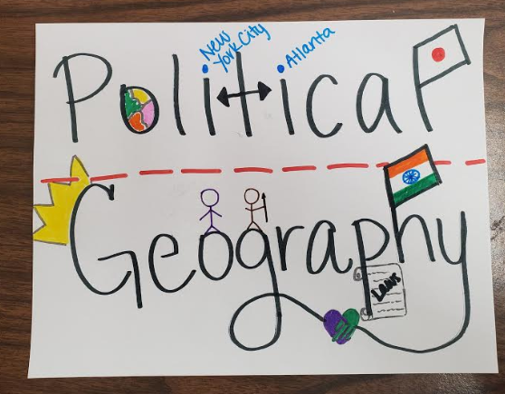

Slide 4
PictoWord Example

Slide 5
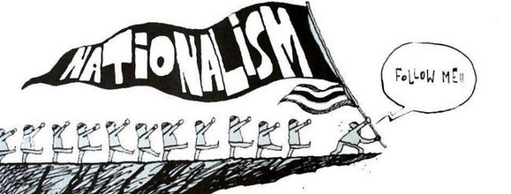
PictoWord Example

Slide 6
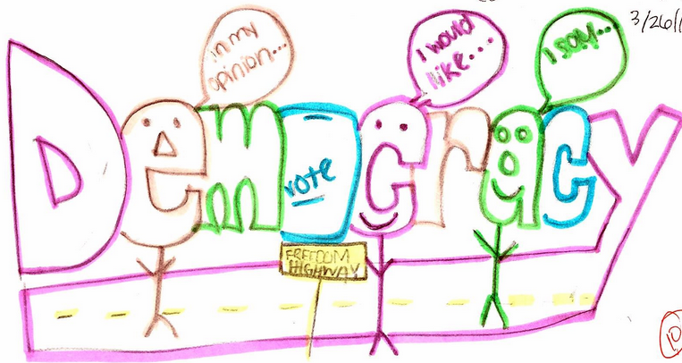
PictoWord Example

Slide 7
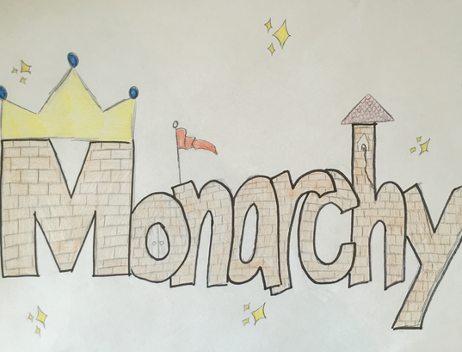
PictoWord Example

Slide 8
PictoWord Example

Slide 9
Military Bases
Georgia provided more military bases for World War I than any other state.
These bases included Fort McPherson, Camp Gordon, Camp Benning, and Camp Stewart.

Slide 10
World War I
Known at the time as the Great War, this war was largely fought in Europe, Africa, and parts of Asia.
Georgia contributed more than 100,000 men and women to the war effort.
1914-1918
Major war primarily between European powers; US entered the war in 1917.

Slide 11
Boll Weevil
A beetle that feeds on flowers and cotton buds.
Not native to the United States.
It proved disastrous to cotton producers in the American Southeast, including those in Georgia, during the Great Depression.
Insect whose larvae feed on cotton crops; decimated cotton production in the Southeastern United States.

Slide 12
Drought
A period of little or no rainfall.
A widespread drought in the United States during the 1930s created the Dust Bowl in parts of the Midwest and West.

Slide 13
Drought of 1924
One of the worst droughts in Georgia’s history; led to a depression in the state that predated the Great Depression

Slide 14
The Great Depression
A sustained period of American economic decline.
It lasted from 1929 until the mid-1940s.
US entry into World War II led to the end of the Great Depression.

Slide 15
Eugene Talmadge
A three-term governor of Georgia who served in the 1930s and 1940s.
Four time Georgia governor that fought against Roosevelt’s New Deal policies.

Slide 16
New Deal
A series of laws enacted by President Franklin Delano Roosevelt during the Great Depression, aimed at rebuilding the American economy.
Name given to a series of federal programs spearheaded by President Franklin Roosevelt in order to help the nation recover from the Great Depression.

Slide 17
Franklin Delano Roosevelt
The president of the United States from 1933 until his death in 1945.
He governed the nation during both the Great Depression and World War II.
He first visited Brunswick, GA, in 1913 on business for the US Navy.
After contracting polio in 1921, he returned to the state, this time to visit Warm Springs, where he hoped the waters would restore him to health.
He later purchased a home there, visiting often, and it was to become the site of his death.

Slide 18
Civilian Conservation Corps
A Great Depression-era work relief program that put young American men to work in rural areas.
A New Deal program that hired unemployed young men to work on public works projects.

Slide 19
Agricultural Adjustment Act
A federal law passed in 1933, ruled unconstitutional, and then modified and passed again in 1938.
It sets quotas on farm produce in an attempt to keep farmers in business during the Great Depression.
A New Deal program that paid farmers a stipend not to grow crops in order to increase the price of agricultural products.

Slide 20
Rural Electrification Administration
A federal agency established by the Rural Electrification Act, which was signed into law by President Franklin Roosevelt in 1936 to bring electricity to rural areas throughout the United States.
The New Deal program designed to build the capabilities to bring electricity to rural areas.

Slide 21
Social Security Administration
It provides an income to elderly people who can no longer work by giving them benefits based on what they paid into the system while working.
New Deal program that provided retirement and unemployment insurance for American taxpayers.

Slide 22
Lend-Lease Act
Act that allowed the US government to send billions of dollars in supplies and military equipment to allied countries in exchange for US rights in the military bases.
The Lend-Lease Act in 1941 let the United States aid the Allied in World War II. It was signed by President Franklin Delano Roosevelt, and it allowed the United States to provide aid to Great Britain.

Slide 23
Pearl Harbor
American naval base in Hawaii; a surprise attack on the base by Japanese forces on December 7, 1941 resulted in the US entering World War II.
A naval base in Hawaii that was attacked by Japan on December 7, 1941, prompting the United States’ entry into World War II.

Slide 24
World War II
The most destructive war in human history; America entered the war in 1941 after the Japanese attack on Pearl Harbor on December 7, 1941.
The largest war in history. Conflict extended into Europe, Africa, Asia, and both Pacific and Atlantic Oceans.

Slide 25
Bell Bomber Plant
Factory located in Marietta, Georgia that produced B-29 bombers for the US war effort.

Slide 26
Liberty Ships
US cargo ships made during World War II. In all 187 of these ships were made in Georgia.

Slide 27
Savannah and Brunswick Ship Yards
Georgia’s two deep water ports; during World War II, 187 Liberty Ships were constructed there.
Two deepwater ports in Georgia where ships were built. Both were extremely important to the United States during World War II.

Slide 28
Richard Russell
Georgia governor and influential long term US Senator.
Former governor of Georgia and US senator. He was known for working to strengthen national defense as well as for opposing civil rights.

Slide 29
Carl Vinson
Georgia Congressman who was an advocate for a strong US military; served 25 terms in the US House of Representatives, making him the longest serving Congressman in US history.
A Georgia native who served in the US House of Representatives. He was the first to hold congressional office for a period of 50 years. He is known as “The Father of the Two-Ocean Navy.”

