Slide 1
PictoWords Assignment

Slide 2
You will create a visual for the 10 terms from the Unit 8 Vocab List assigned by Matello. (Students should contact me to be assigned their words.)
You will show your understanding of the word by creating a visual that uses the actual word as part of the image. See the examples that follow...

Slide 3
PictoWord Example

Slide 4
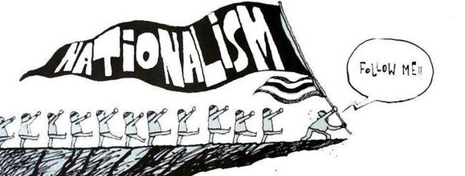
PictoWord Example

Slide 5
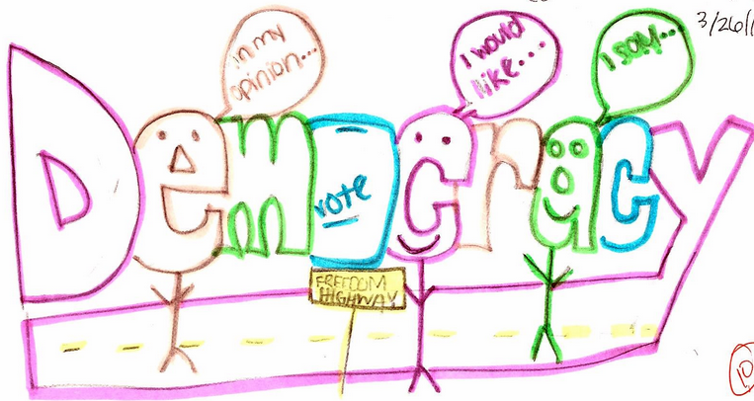
PictoWord Example

Slide 6
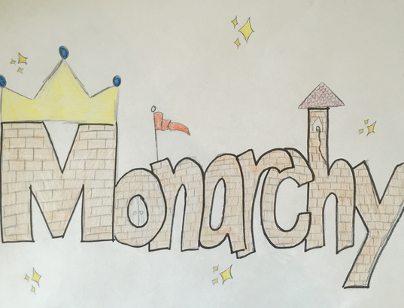
PictoWord Example

Slide 7
PictoWord Example

