Slide 1
Insert your text in this box…
Be sure to include:
- A message that provides clues about the place
- Lots of detailed information to demonstrate the personality of the place you are describing.
- Include both physical and human characteristics
- Address your postcard to someone!
Do NOT:
- Give away the name of your place in your message!
Feel free to change the font, size, and color to personalize your message.
***Be sure to delete all of this information when you insert your message.
Put the name and address of the person you’re “sending” your postcard to. The information can be made up!

Slide 2
Use this slide to insert your visuals… - Be sure images are reflective of your descriptions - Can be hand drawn or digital images - The name of your location

Slide 3
Hi Charlie,
I hope that you are well! I wanted to send you an update about my travels…
This city is so historic and beautiful, but it is SOOOOOO hot and humid! I guess that’s what I get for visiting a city in the South during the summer, huh? I have been spending a lot of time outside as I go site-seeing. The heat and the never-ending hills have absolutely nothing on the traffic here. It’s insane!
There is so much culture and stuff to see here! Did you know the Olympics were held here in 1996? There’s a large park in the middle of the city for it. Even just walking through the park, you see so much! I saw a movie set as I went to go to the museums this morning. I guess they film a bunch of movies here. On my agenda today are the World of Coke, the Aquarium, and the Center for Civil and Human Rights. It’s awesome that they have the Center here because this city was a major part of the Civil Rights Movement.
Planning on doing some more site-seeing tomorrow. Thinking about tubing on the Chattahoochee River, hiking at Stone Mountain, or swimming in Lake Lanier. I’ll send you another update about that.
All my love!!!
Charlotte E. Matello
12345 Themes Way
Geography, GA 11630

Slide 4
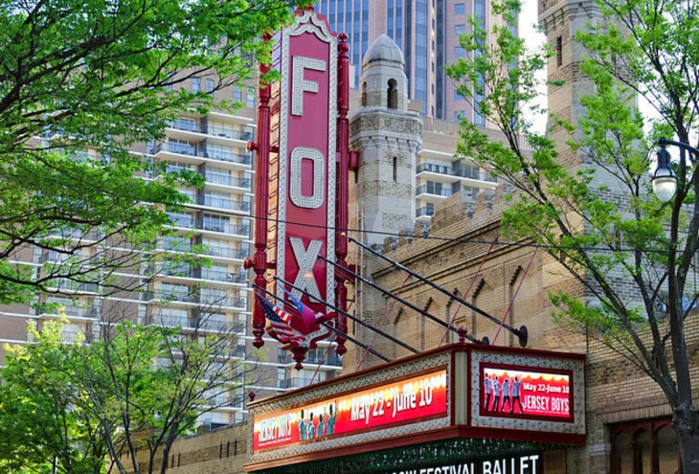
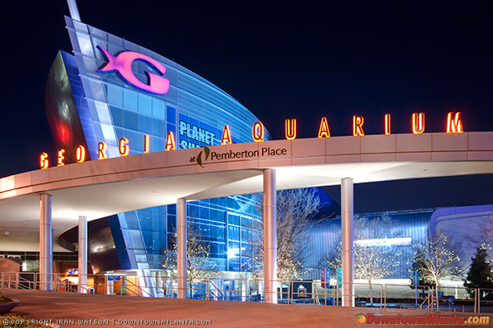
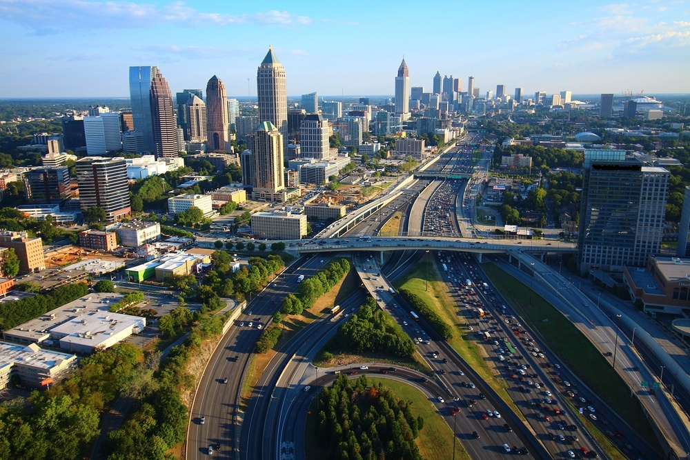
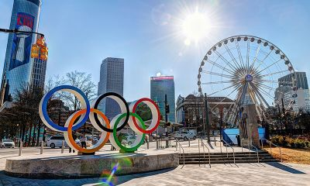
Atlanta, Georgia

