Slide 1
Survivor Stories: Darfuri Children's Pictures

Slide 2
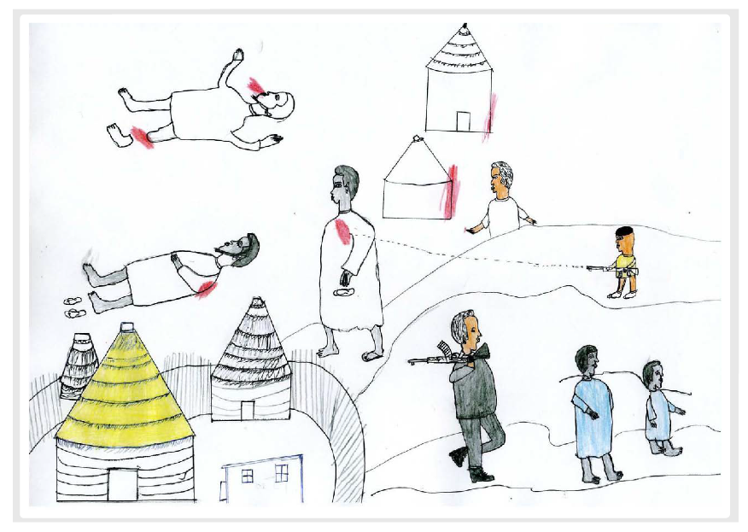
Image 1

Slide 3
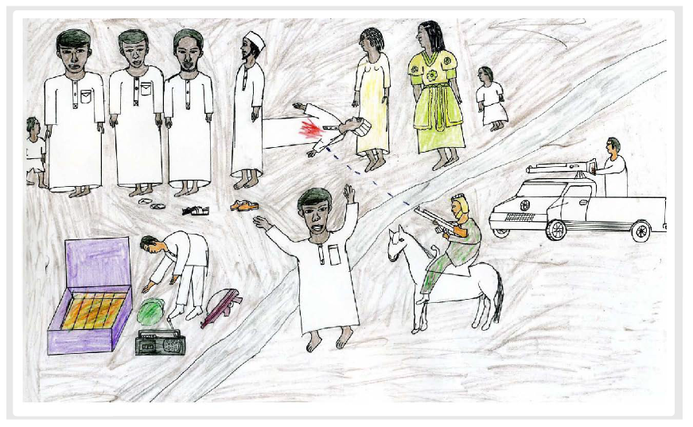
Image 2

Slide 4
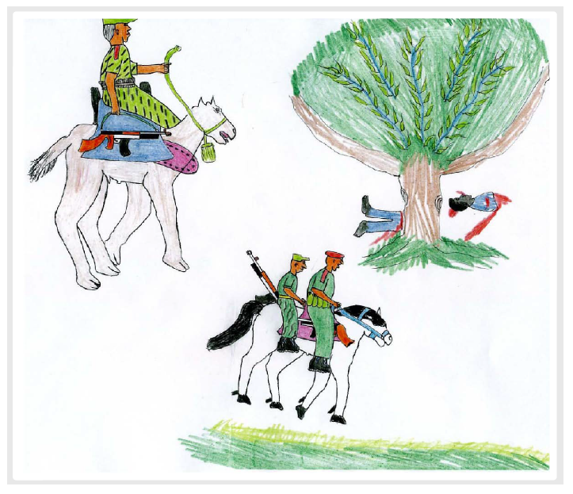
Image 3

Slide 5
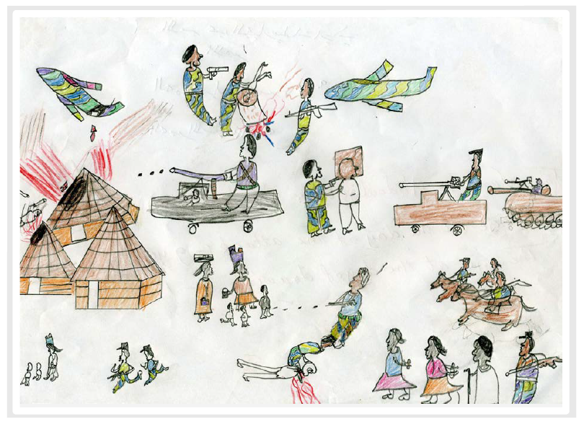
Image 4

Slide 6
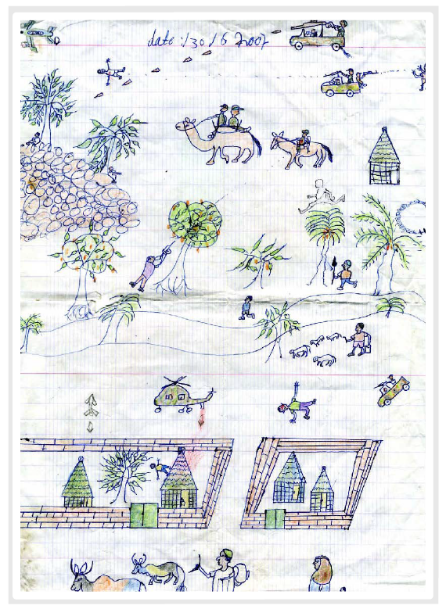
Image 5

Slide 7
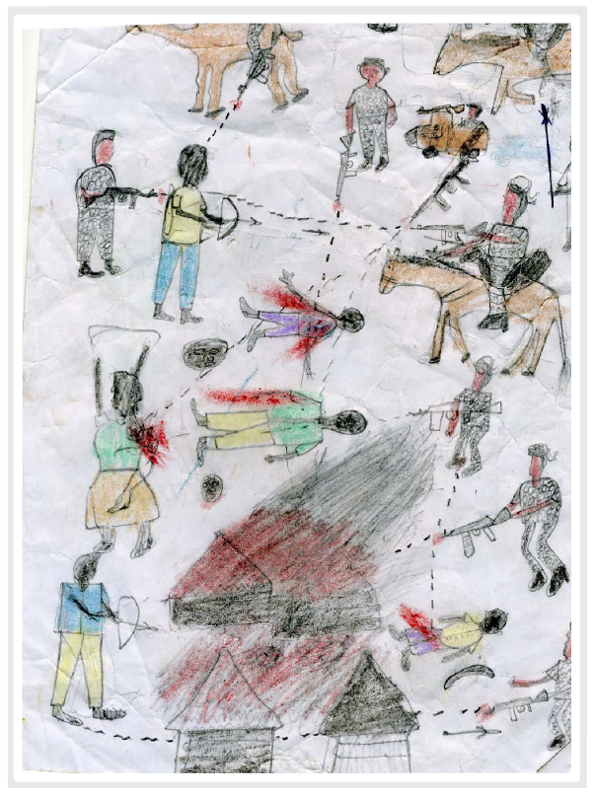
Image 6

