Slide 1
APWH Unit 1: The Global Tapestry
c. 1200 CE– c. 1450 CE
Ch 8; p. 95
Source: AP World History Crash Course by JP Harmon

Slide 2
China’s Dynasties
Sui -- 581-618 CE
Tang – 618-907 CE
Song– 960-1279 CE

Slide 3
Fall of Han in 220 CE
Led to rise of regional rulers again
From c. 220 – 581 CE
Another “warring states period”

Slide 4
Sui Dynasty 581-618 CE
Short-lived but policies enacted continued
Public works projects revived
Grand Canal
Great Wall
Reinstituted Confucian Exam system for civil service
Buddhism increased in popularity

Slide 5
Tang Dynasty 618-907 CE
Represents the Golden Age of Chinese Culture
Ruled from Chang’an (modern day Xi’an)
Continued construction of Grand Canal and Great Wall
Continued Civil Service Exam
Changed the official stance on Buddhism
Gov’t bureaucracy became more complex

Slide 6
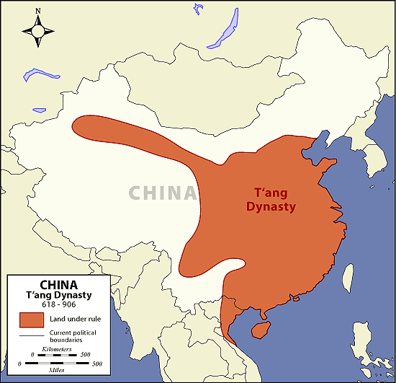
Tang Dynasty
Size similar to Han
most of modern-day China
Expanded the same way as others
conquest, diplomacy, trade
Raised taxes to pay for running of gov’t
Conducted first census
C. 750CE 50 mil people

Slide 7
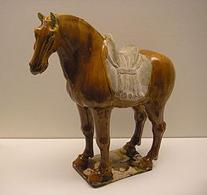
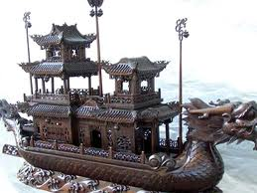
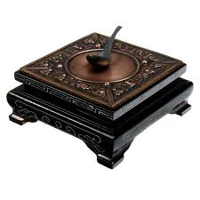
Tang Art
Glazed porcelain horses
Technology
printing, gunpowder, medicine, compass and ship construction

Slide 8
Song Dynasty 960-1279 CE
Tang overthrown by Mandate of Heaven (floods, famine, pirates)
Transition to Song fairly stable because of faith in Mandate of Heaven

Slide 9
Song Dynasty
Continuities
Supported trade along Silk Road
Development of cities
Confucian Exam System
Changes
Development of Neo-Confucianism
Confucianism + Buddhism + Taoism = Neo-Confucianism
Became a religion promising eternal reward
Example of cultural syncretism
Added practice of foot-binding of women

Slide 10
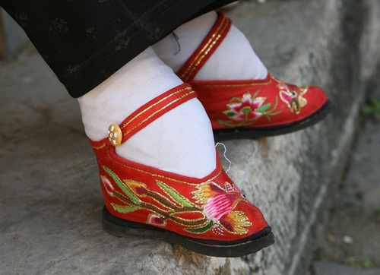
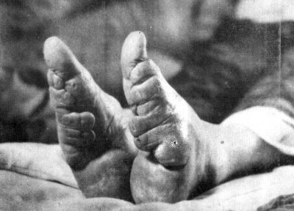
Song Dynasty
One key difference
Reduction of the status of women during the Song period
Foot-binding forced dependence of women

Slide 11
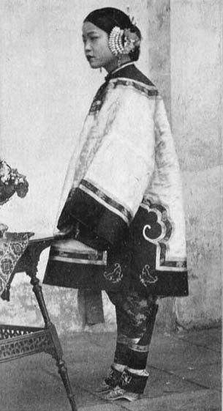
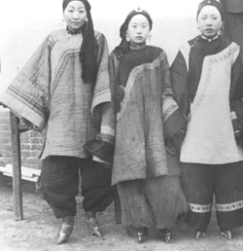
https://www.youtube.com/watch?v=P56LAPlFfgk

Slide 12
China’s Influence on Asia
Sinification
term for the spread of Chinese culture
In Korea
tributary to China under the Tang
borrowed ideas from China
Incorporated Confucian teachings
Adopted Chinese
writing, religion (Buddhism), fashion and architecture

Slide 13
China’s Influence on Asia
In Japan—never conquered by China
Intentionally chose Sinification
Writing, bureaucracy, & belief systems
Buddhism – (feared by the governments)
Confucianism
Heian Era (794-1185)
Decadence led to loss of power and placement of Shogun
Emperor’s role greatly reduced
Japan becomes feudal

Slide 14
China’s Influence on Asia
In Vietnam
Many revolts
Women didn’t accept Confucian teaching of male dominance
Tang Dynasty limited success in conquering
New strain of rice to China

