Slide 1
Create a list of as many “inalienable rights of all members of the human family” (human rights) as you can think of…

Slide 2
United Nations
International Organization
Established October 24, 1945
Replace the League of Nations
193 Member Nations
Home Office = in NYC
Notable non-member countries
- Vatican City
- Palestine
- Kosovo
- Taiwan

Slide 3
United Nations
Purposes
Maintain international peace and security
Develop friendly relations among nations
Achieve international co-operation in solving international problems
Encourage respect for human rights and for fundamental freedoms
Be a center for harmonizing the actions of nations
Functions
Prevent conflict, make peace, peacekeeping & creating conditions to allow peace to hold
Promote sustainable development
Deliver humanitarian aid
Protect Human Rights
Uphold International Law

Slide 4
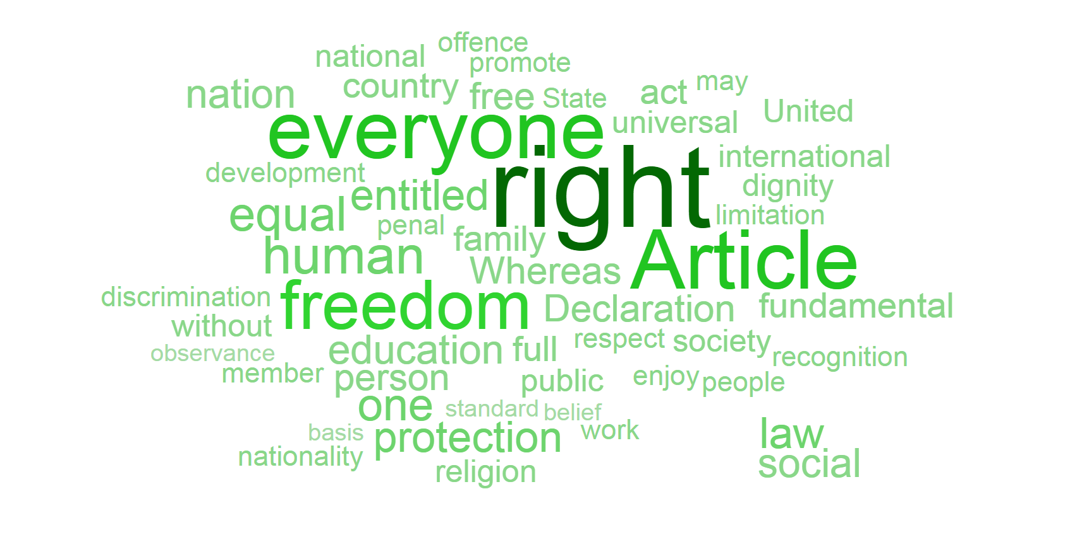

Slide 5
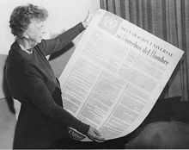
Universal Declaration of Human Rights
Adopted by the United Nations General Assembly on December 10, 1948

Slide 6
Universal Declaration of Human Rights Preamble
Whereas recognition of the inherent dignity and of the equal and inalienable rights of all members of the human family is the foundation of freedom, justice and peace in the world,
Whereas disregard and contempt for human rights have resulted in barbarous acts which have outraged the conscience of mankind, and the advent of a world in which human beings shall enjoy freedom of speech and belief and freedom from fear and want has been proclaimed as the highest aspiration of the common people,

Slide 7
Universal Declaration of Human Rights Preamble
Whereas it is essential, if man is not to be compelled to have recourse, as a last resort, to rebellion against tyranny and oppression, that human rights should be protected by the rule of law,
Whereas it is essential to promote the development of friendly relations between nations,
Whereas the peoples of the United Nations have in the Charter reaffirmed their faith in fundamental human rights, in the dignity and worth of the human person and in the equal rights of men and women and have determined to promote social progress and better standards of life in larger freedom,

Slide 8
Universal Declaration of Human Rights Preamble
Whereas Member States have pledged themselves to achieve, in co-operation with the United Nations, the promotion of universal respect for and observance of human rights and fundamental freedoms,
Whereas a common understanding of these rights and freedoms is of the greatest importance for the full realization of this pledge,

Slide 9
Universal Declaration of Human Rights Preamble
Now, Therefore THE GENERAL ASSEMBLY proclaims THIS UNIVERSAL DECLARATION OF HUMAN RIGHTS as a common standard of achievement for all peoples and all nations, to the end that every individual and every organ of society, keeping this Declaration constantly in mind, shall strive by teaching and education to promote respect for these rights and freedoms and by progressive measures, national and international, to secure their universal and effective recognition and observance, both among the peoples of Member States themselves and among the peoples of territories under their jurisdiction.

Slide 10
UDHR Quilt Activity
Make a square out of the paper provided
Write the number and the text of your article on the back
Use the sheet to visually represent the content of your UDHR Article
Symbols, Images, etc.
No more than 5 words
Must have COLOR
Use the ENTIRE square
People should be able to ID your article JUST by looking at your visual

Slide 11
Human Rights Quick Write Prompts
Which right do you think is the most important? Why?
Name 3 ongoing human rights violations.

